Slide 1
Decision making for movements under uncertainty
Clara Kuper, PhD Student

Slide 2
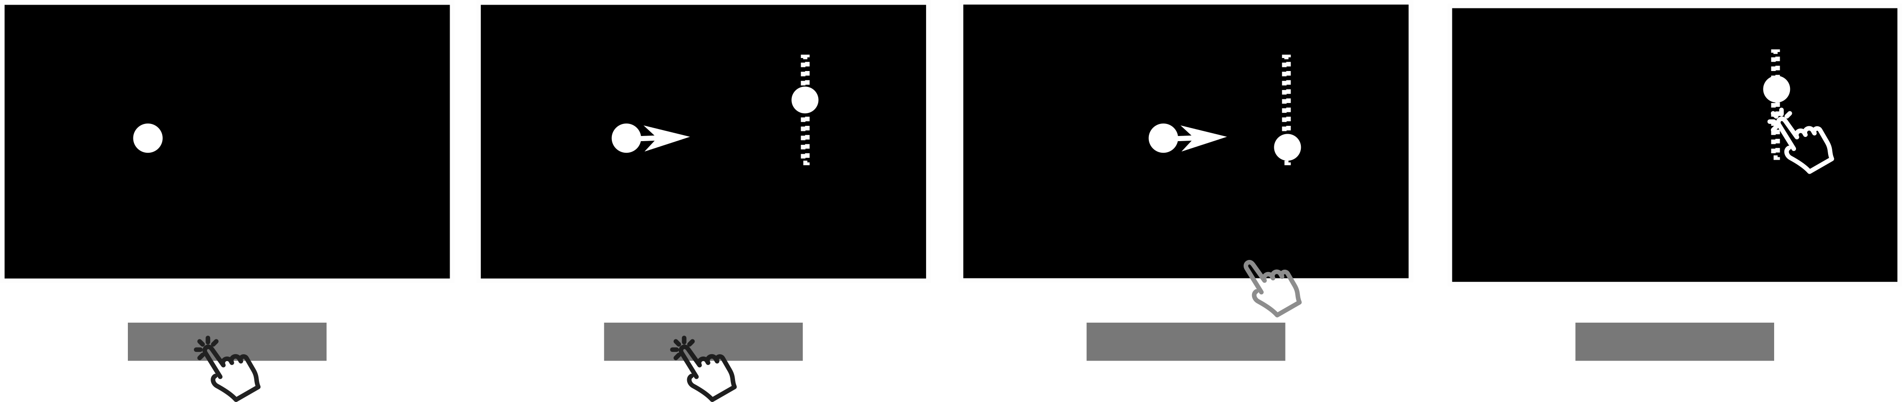
Paradigm
-750 to -500 ms
0 ms
250 - 1750 ms
500 to 2000 ms
Fixation
Start Signal
Attacker moves
New targets appear along goal
Go/ No-Go Decision
Latest point to start hand movement
Intercept with Goal

Slide 3
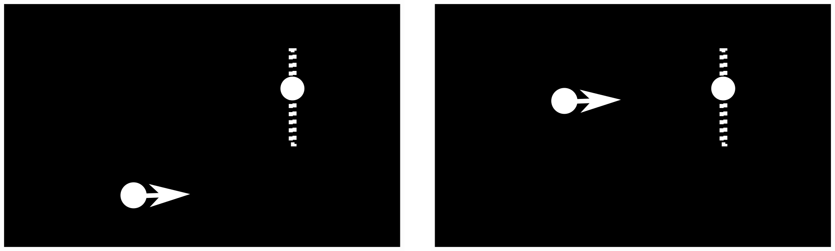
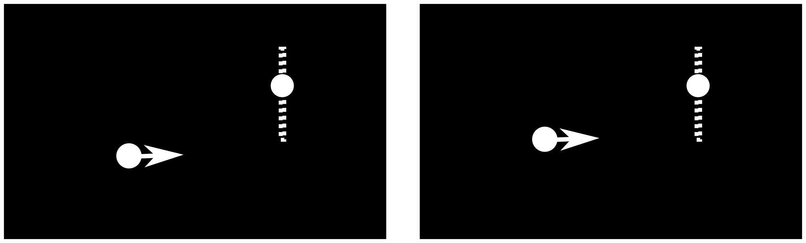
Easy Trials
Hard Trials
Randomly interleaved trials:
1.0 dva (easiest) to 0.05 dva (hardest)
Blocks:
0.5 ms to 2 sec flight time
(more time to execute the movement, the number of presented targets is equal)

Slide 4
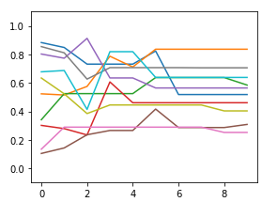
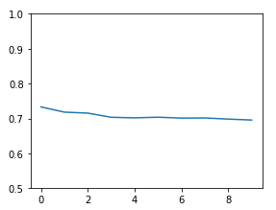
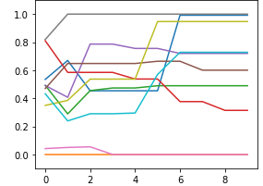
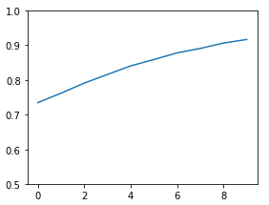
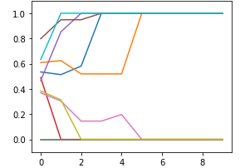
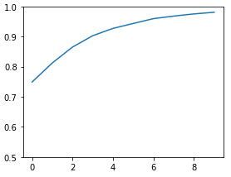
0.05 dva
0.05 dva
Certainty about the location
The probability of the attacker being inside the goal can be calculated.
-> cumulative uniform distribution
Probability changes rapidly
Timepoint of change depends on separation
1.025 dva
1.025 dva
Probabilty of a hit
Mean probability collapsed over go/no-go
2 dva
2 dva
n presented targets

Slide 5
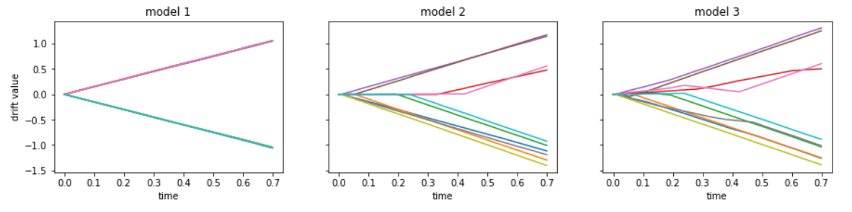
Decision making models
Parameters needed to estimate reaction time:
Variance/Noise
Drift rate
Non-Decision constant
4.63
7.58
0.47
Variance/Noise
Drift weight (of hit probability)
Non-Decision constant
Threshold (to start drift)
0.42
8.28
0.09
0.14
Variance/Noise
Drift weight (of hit probability)
Non-Decision constant
0.49
9.12
0.11

Slide 6
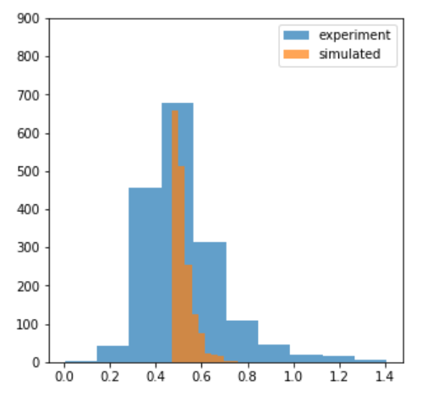
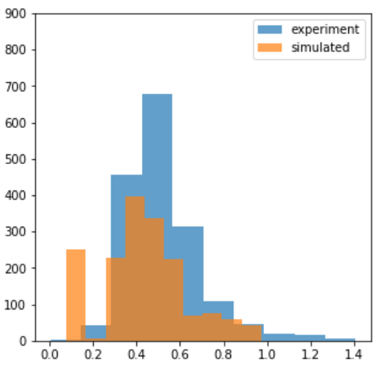
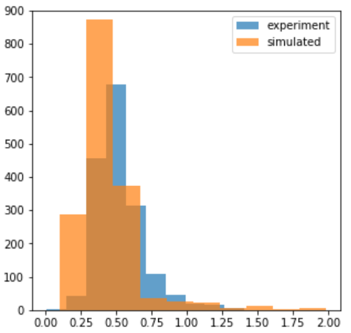
Model 1
Model 2
Model 3

Slide 7
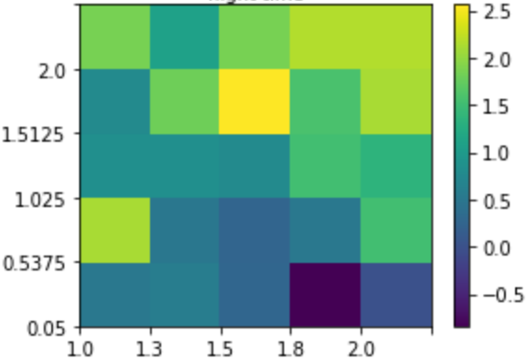
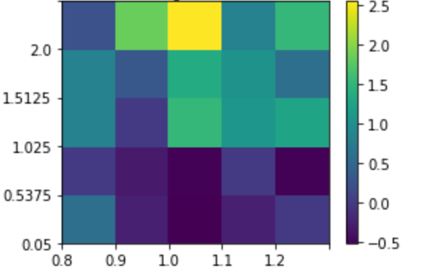
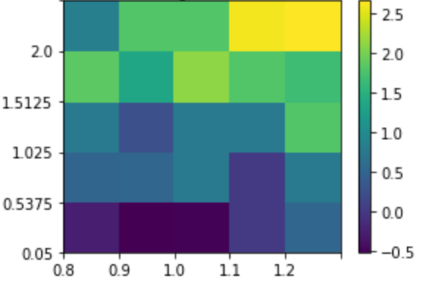
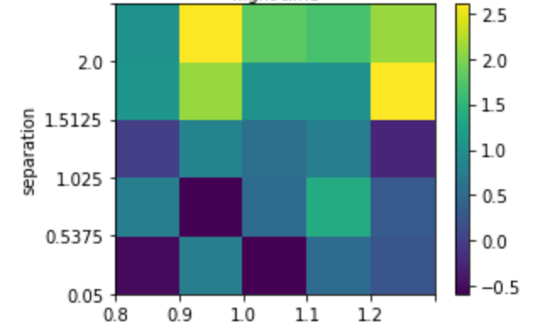
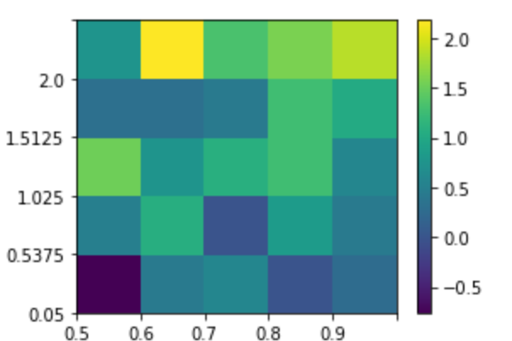
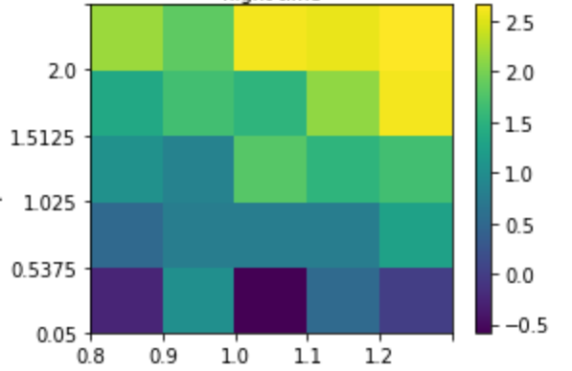
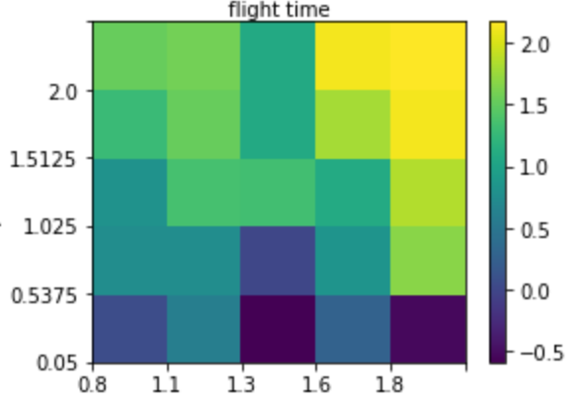
Performance by speed and separation
Separation Attacker-Goal in dva
Flight time in seconds

Slide 8
Questions/ Points to discuss
More time for decision making, with the same amount of information -> consequence?
Drift diffusion: 1 process, 2 boundaries? 2 processes, 2 boundaries? 1 process, 1 boundary?
Eye movements vs hand movements -> which saccades are relevant?

